Slide 1
Project report - Airline Reservation System Team3 – Jun 2020

Slide 2
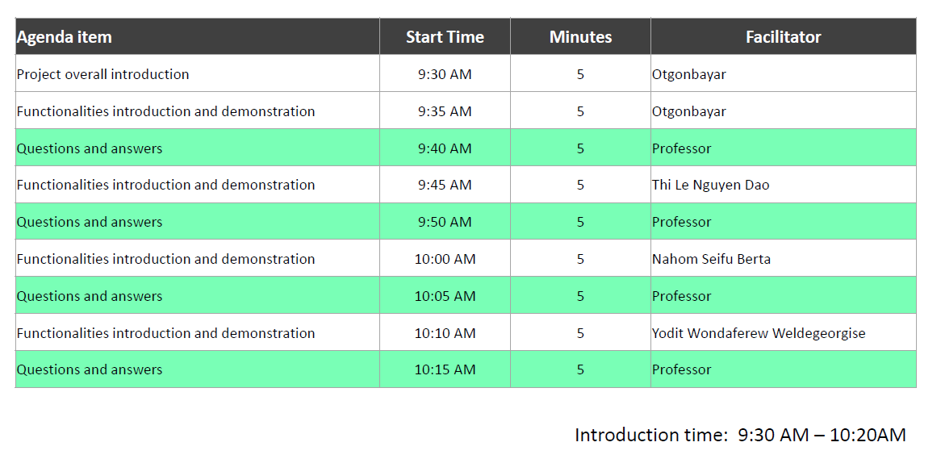
Agenda

Slide 3
Project summary information
Project goal
The goal of this project implementation is every member of the team to practice microservice’s design, implementation, and all topics which we learned during this course on each of features of the project.
Team members
 | Full Name | Student ID
1. | Otgonbayar Mijiddorj | 610764
2. | Thi Le Nguyen Dao | 611070
3. | Nahom Seifu Berta | 611108
4. | Yodit Wondaferew Weldegeorgise | 610748
GitHub
https://github.com/oogii0713/CS544-EA-Project

Slide 4
System diagram
Eureka Server
Service Registration and Discovery
Service name lookup
requests and responses
Gateway
Port:8080
Request
Airport
Service
(Port:8081)
AirportService
DB
Aggregation
Service
Response
Client System
Request
Request
Reservation
Service
(Port:8082)
Reservation
ServiceDB
Response
Response
Authentication
Authorization
Schedule Request
Scheduling and Email Service
Port:8085
Scheduling
DB
Response
User
DB

Slide 5
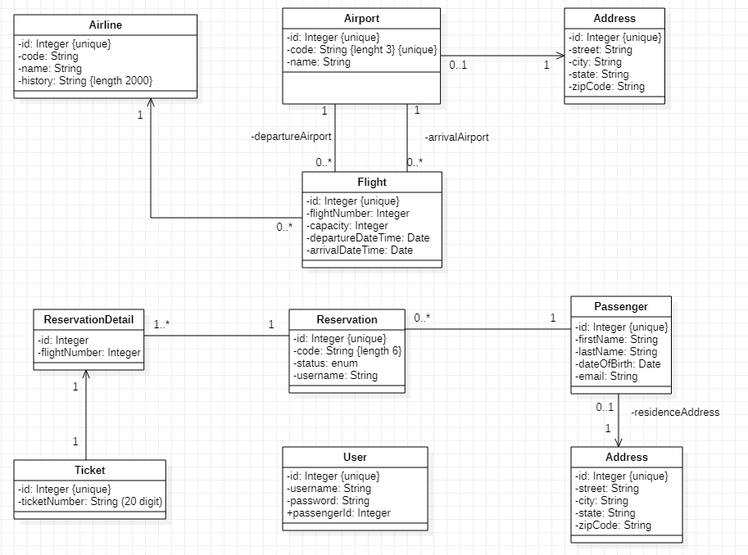
Class diagram

Slide 6
Airline reservation system application functionalities
 |  | Implementation | Owners
Passenger, Agent functionalities | View list of airports | √ | Thi Le Nguyen Dao
 | View list of airlines flying out of an airport | √ | Thi Le Nguyen Dao
 | View list of flights between a departure and destination for a date | √ | Yodit Wondaferew Weldegeorgise
 | View list of own reservations | √ | Thi Le Nguyen Dao
 | View details of a reservation (flights, departure times, etc.) | √ | Thi Le Nguyen Dao
 | Make a reservation (note: payload will be a list of flights) | √ | Yodit Wondaferew Weldegeorgise
 | Cancel a reservation | √ | Nahom Seifu Berta
 | Confirm and purchase a reservation. | √ | Nahom Seifu Berta
Admin functionalities |  | √ | Otgonbayar Mijiddorj
Email reminder |  | √ | Nahom Seifu Berta
Spring security using JWT |  | √ | Otgonbayar Mijiddorj
Aggeration Server sekelton |  | √ | Thi Le Nguyen Dao
Exception handling sekelton across microservices |  | √ | Otgonbayar Mijiddorj
Create an automated pipeline for CI/CD |  | ×

Slide 7
Thank you, Professor

